Slide 1

SQL Project on pizza bite

Slide 2


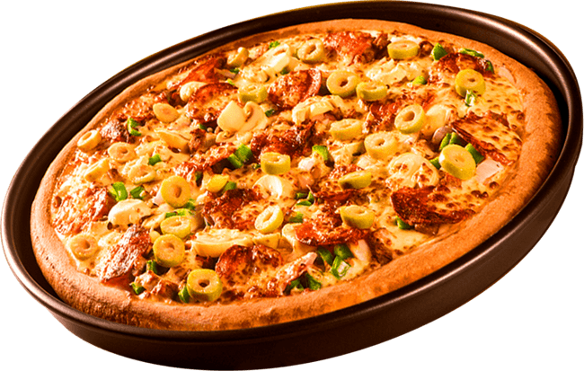

Overview
This SQL-based project focuses on analyzing pizza sales data to derive actionable insights and optimize business performance. By examining order trends, revenue generation, and customer preferences, the project identifies key metrics such as top-selling pizza types, most popular sizes, and revenue contributions by category. It also explores time-based order patterns and cumulative revenue growth to support operational efficiency and strategic decision-making.

Slide 3





DATABase
pizza_types
pizzas
orders
order_details

Slide 4

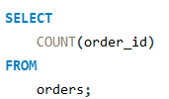


Retrieve the total number of
orders placed.

Slide 5
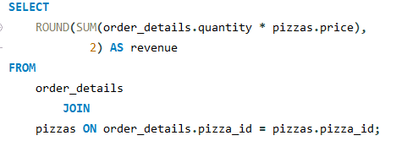

CALCULATE THE TOTAL REVENUE GENERATED FROM PIZZA SALES.

Slide 6


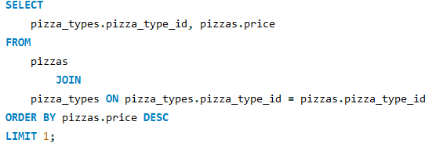


Identify the highest-priced pizza.

Slide 7

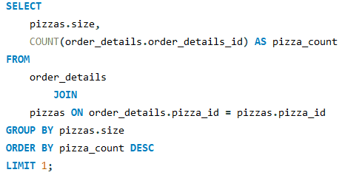




IDENTIFY THE MOST COMMON PIZZA SIZE ORDERED.

Slide 8

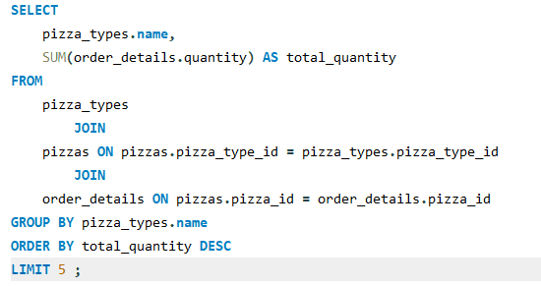
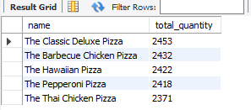
List the top 5 most ordered pizza types along with their quantities.

Slide 9

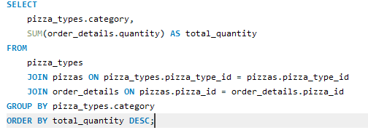
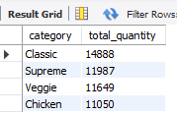
Join the necessary tables to find the total quantity of each pizza category ordered.

Slide 10
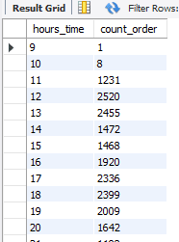
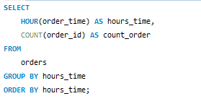
Determine the distribution of orders by hour of the day.

Slide 11
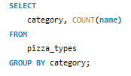
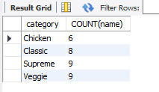
Join relevant tables to find the category-wise distribution of pizzas.

Slide 12
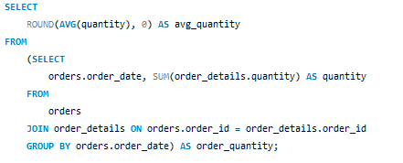


Group the orders by date and calculate the average number of pizzas ordered per day.

Slide 13
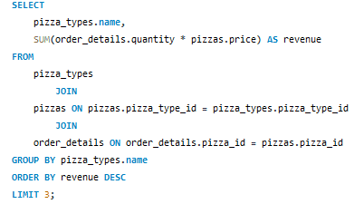
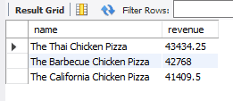
Determine the top 3 most ordered pizza types based on revenue.

Slide 14

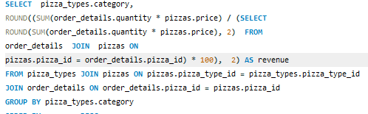
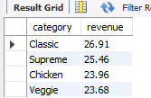
Calculate the percentage contribution of each pizza type to total revenue.

Slide 15

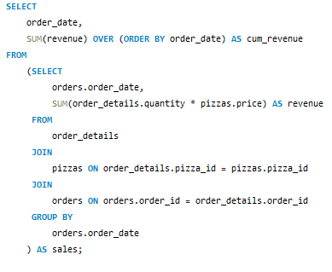
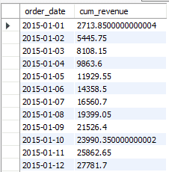
Analyze the cumulative revenue generated over time.

Slide 16

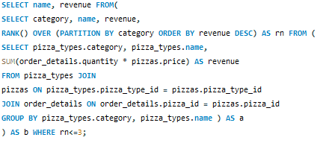
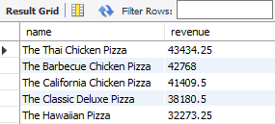
Determine the top 3 most ordered pizza types based on revenue for each pizza category.

